Slide 1
Risk of Injury in a Vehicle Collision Based on Environmental Factors

Slide 2
Introduction
Driving is a freeing experience and collisions are a necessary risk.
Injury from collision is a risk most would like to avoid.
By Identifying environmental factors that lead to the most injury, measures to mitigate this risk can be taken.

Slide 3
Data set: Collisions – All Years
Source: Seattle’s department of Traffic Records
Collected by the Seattle Police Department
Environmental Variables include Weather, Road Conditions, and Light Conditions
Collision Categories
Code | Definition | Count
3 | Fatality | 349
2b | Serious Injury | 3,098
2 | Injury | 58,688
1 | Property Damage | 137,485
0 | Unknown | 21,635

Slide 4
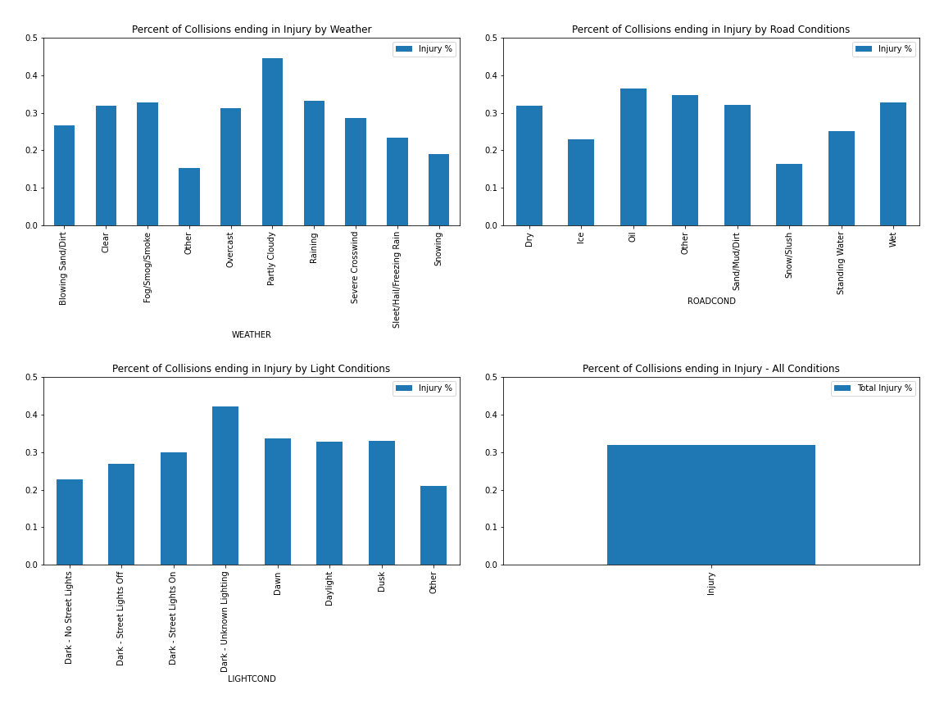
Exploration
Chart proportion of collisions resulting in injury for each type of Weather, Road Condition, and Light Condition
The low proportion of injury in the snow/slush road condition was surprising
Most categories were with in an expected range of the total data set.

Slide 5
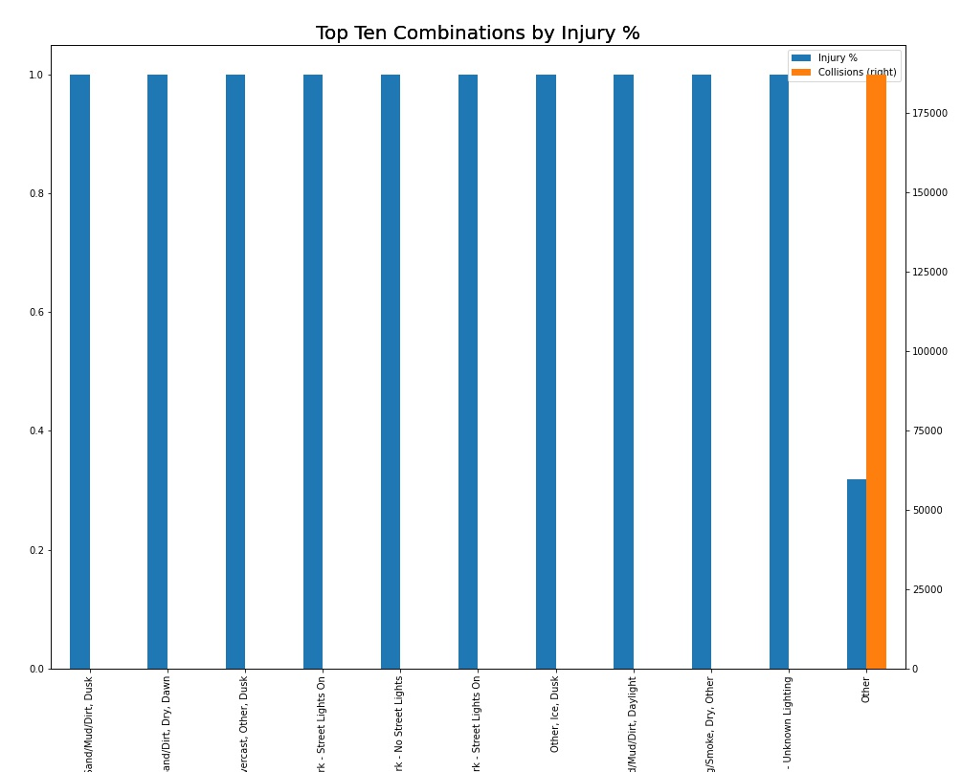
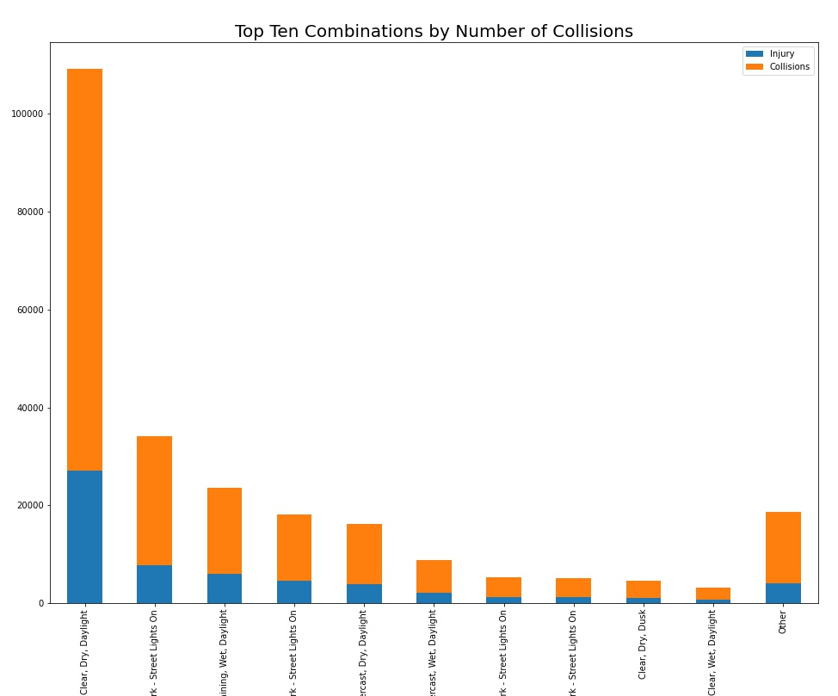
Exploration
Combinations by Injury % had many combinations with very few collisions and 100% injury rate
These were removed for model training
Most collisions occur during clear weather, with dry roads, during the day
Because the assumption is a collision, this was not adjusted for

Slide 6
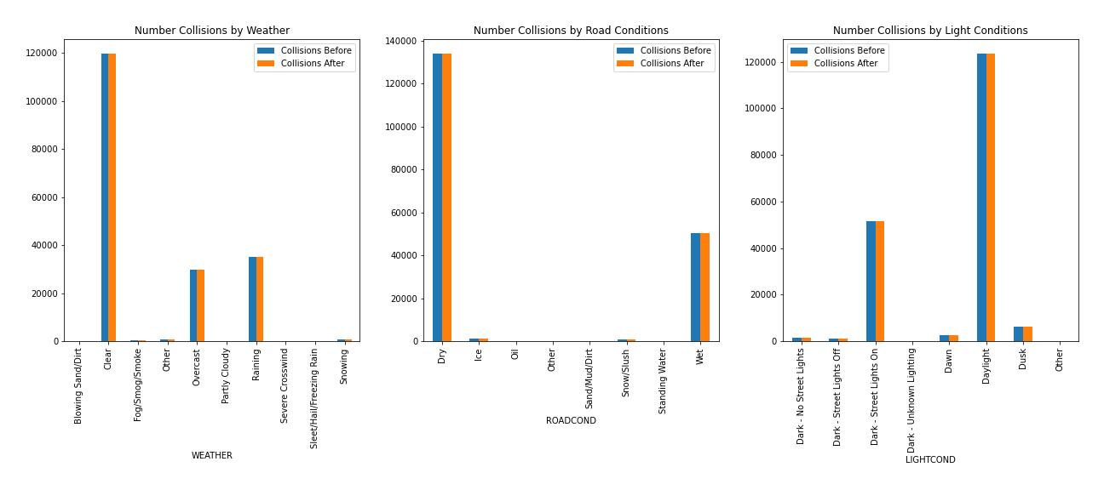
Removing Categories with less than 5 Collisions
Removed all combinations with fewer than 5 collisions
Most categories volumes did not change enough to warrant concern

Slide 7
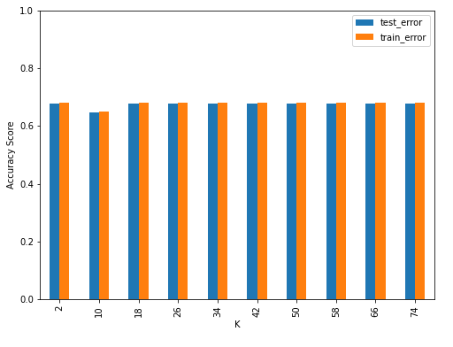
K-Nearest Neighbors
K-Nearest Neighbors compares an input to the K nearest points to choose the result.
K-Nearest Neighbors algorithm in the scikit learn library allows for probabilistic outputs
Probabilistic outputs are necessary because the proportion of Injury will likely lead to classifiers they do not predict Injury
K-Nearest Neighbors accuracy is similar between the train and test sets
The accuracy seems to stop increasing around K = 34

Slide 8
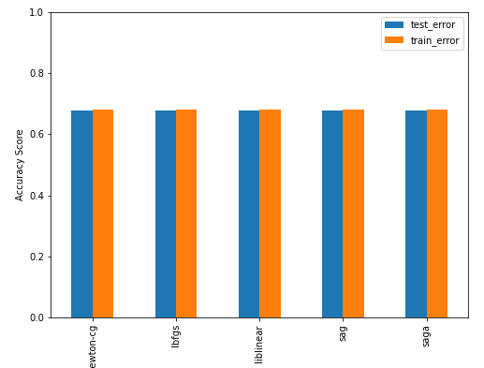
Logistic Regression
Logistic Regression is a statistical model that models a probability of binary outcome.
The probabilistic nature makes it ideal for this problem
Considering multiple solvers,
All solvers performed equally well
The newton-cg solver was chosen

Slide 9
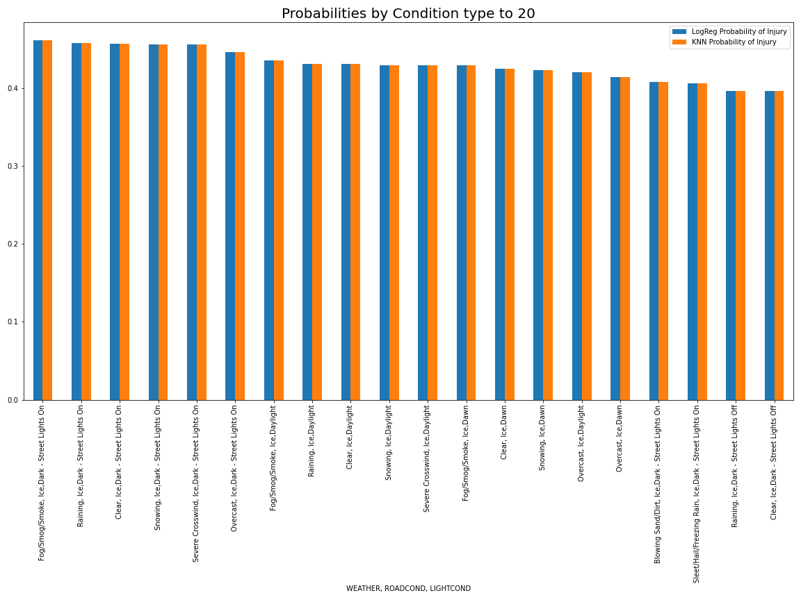
Comparing the Models
K-Nearest Neighbors
  F1-Score = .551629
  Jaccard Score = 0
  No inputs predicted Injury
Logistic Regression
  F1-Score = .551629
  Jaccard Score = 0
  No inputs predicted Injury
With no difference in the accuracy of the models, we compare the probabilities.

Slide 10
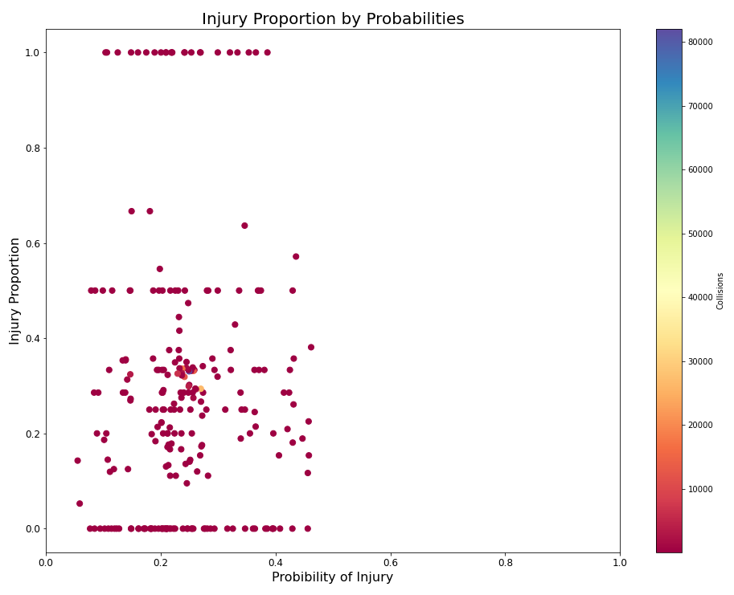
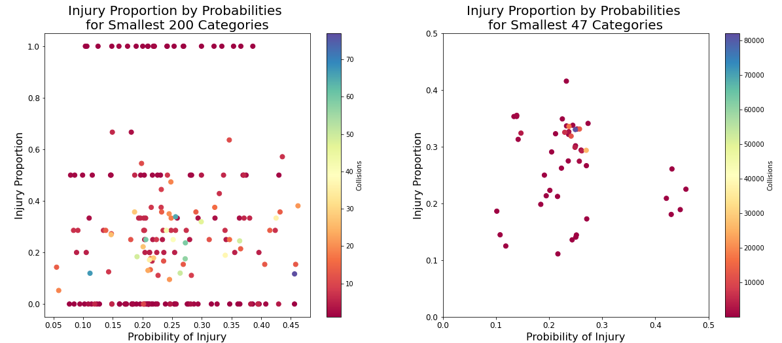
Evaluating Logistic Regression
Splitting by collision volume demonstrates the sample size problem
All of the 100% and most of the 0% points seem to have fewer than 10 collisions.
Many of the probabilities line up with the data’s proportions
Many More don’t match at all

Slide 11
Conclusion
Analyzing only weather, road conditions, and light conditions can not predict injury
Illuminates the most dangerous situations, such as icy roads at night.
A future analysis could include
  Intoxication
  Drowsiness
  Speeding
Driver specific criteria will likely be a better predictor of injury.

